Slide 1

Teamwork & Collaboration
Presented by: Hensi Vaghela

Slide 2
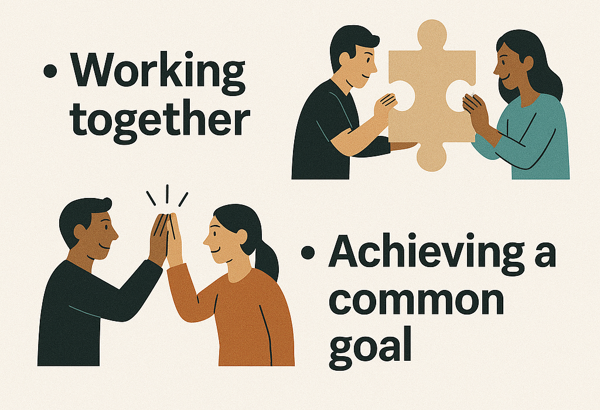

What is Teamwork?

Slide 3

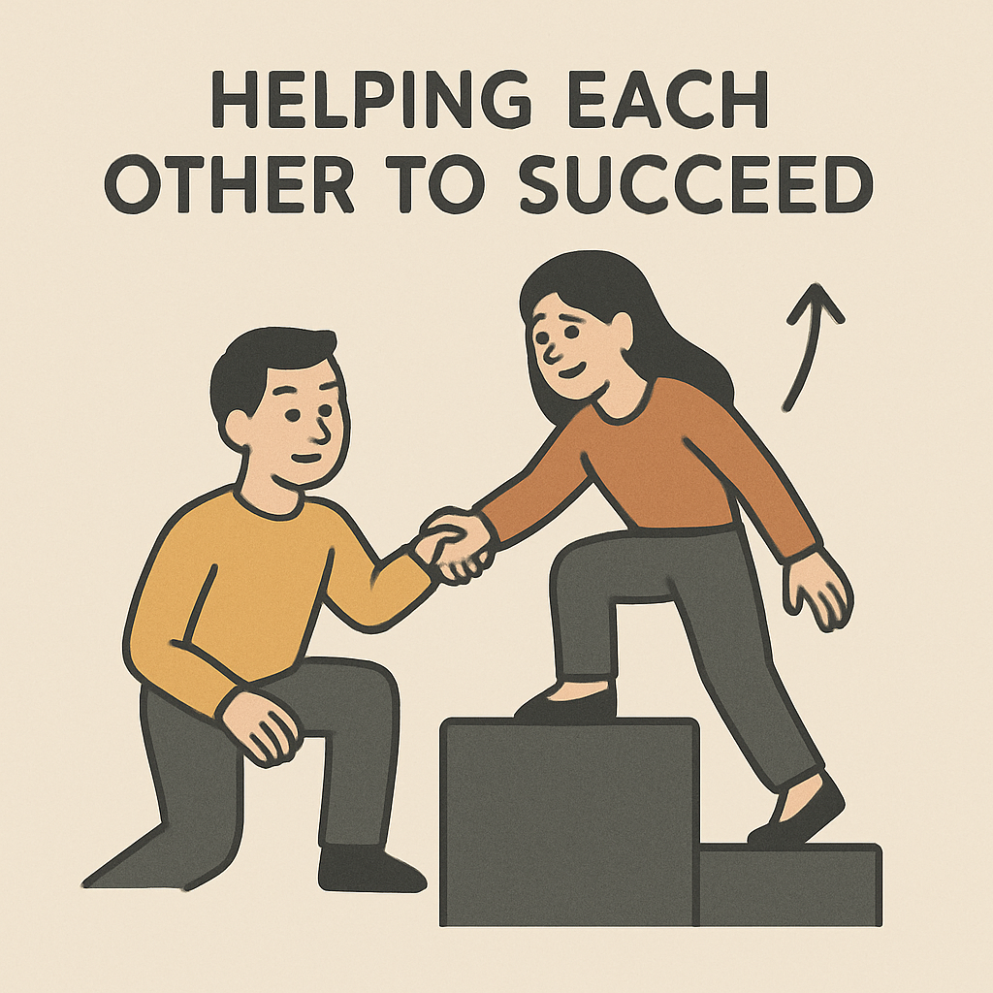
What is Collaboration?

Slide 4
Key Elements of Teamwork & Collaboration
Communication
Sharing responsibilities
Supporting each other
Respect and trust

Slide 5
Benefits of Teamwork & Collaboration
• Better outcomes and performance
• Increased creativity and innovation
• Stronger relationships and trust
• Faster problem solving

Slide 6

Final Thoughts

Slide 7

Thank You
Team work
Makes the
Dream work

